Slide 1
Foundations of Computer Science (26CSE0103)
Prepared By: Dr. Tajinder Kaur
Chitkara University Institute of Engineering and Technology,
Chitkara University, Punjab

Slide 2
UNIT-2 -Memory Hierarchy and Classification
Contents
Memory layers from registers to hard disk
Volatile vs non-volatile memory;
RAM types (SRAM, DRAM) and ROM types (PROM, EPROM, EEPROM).
Secondary Storage Ecosystems: Structural mechanics, magnetic storage (HDDs) vs. solid-state technology (SSDs, NVMe), flash media.

Slide 3
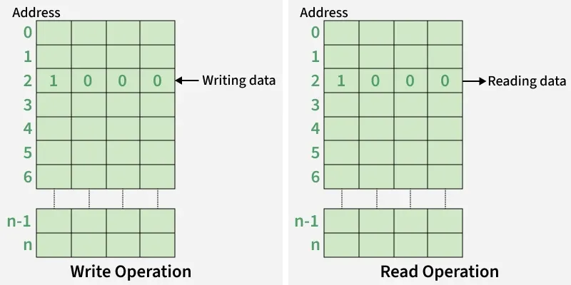
Introduction to Memory and Memory Units
Memory is an essential component of a computer system, responsible for storing data and instructions needed for processing. It enables the CPU to execute programs efficiently and ensures that the system operates properly.
Memory Cell: The smallest storage unit that holds 1 bit of data. Each address in memory typically refers to a byte.
Word & Byte: A word is a group of bits; 1 byte = 8 bits.
Capacity: Total number of bits a memory can hold.

Slide 4
Memory Unit
A memory unit is a standard unit used to measure the amount of data that can be stored, processed, or transferred in a computer system. It represents the storage capacity of memory and storage devices.
The smallest memory unit is a Bit (0 or 1) and larger units are KB, MB, GB, TB, PB, EB, ZB, and YB.
A Byte is the basic unit of storage and equals 8 bits.
Memory units are used to measure file sizes, RAM capacity, and storage device capacity.
Computers use the binary number system, so memory units are typically based on powers of 2 (1024).
Example: A computer with 8 GB RAM can store approximately 8 gigabytes of data in its main memory.

Slide 5
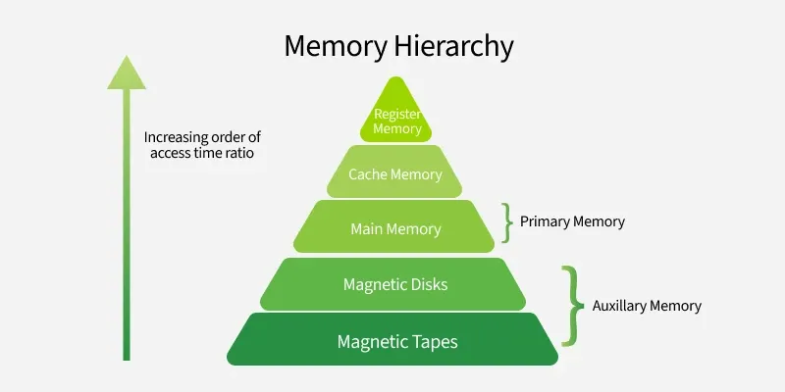
Memory layers from registers to hard disk

Slide 6
Volatile and Non-Volatile Memory
The main memory of a computer is typically categorised as volatile and non-volatile
Volatile Memory | Non-Volatile Memory
Volatile memory is the type of memory in which data is lost as it is powered-off. | Non-volatile memory is the type of memory in which data remains stored even if it is powered-off.
In volatile memory, the processor has direct access to data. | In non-volatile memory, processor has no direct access to data.
It is faster than non-volatile memory. | It is slower than volatile memory.
RAM(Random Access Memory) is an example of volatile memory. | ROM(Read Only Memory) is an example of non-volatile memory.
Volatile memory generally has less storage capacity. | Non-volatile memory generally has more storage capacity than volatile memory.
In volatile memory, the program's data are stored which are currently in process by the CPU. | In non-volatile memory, any kind of data which has to be saved permanently are stored.
Volatile memory is more costly per unit size. | Non-volatile memory is less costly per unit size.
Volatile memory has a huge impact on the system’s performance. | Non-volatile memory has a huge impact on a system’s storage capacity.

Slide 7
Main Memory (Volatile) The memory unit that communicates directly within the CPU, Cache memory is called main memory. It is fast memory used to store data during computer operations. Main memory is made up of RAM and ROM, majority part consists of RAM.
RAM Random Access Memory
DRAM: Dynamic RAM, is made of capacitors. It is slower and cheaper than SRAM.
SRAM: Static RAM, is made of flip-flop that consists of transistors, costly than DRAM but fast.

Slide 8
SRAM (Static RAM)
Static Random Access Memory (SRAM) is a type of volatile memory that stores data using flip-flop circuits. It does not need to be continuously refreshed like DRAM, making it faster but more expensive. SRAM is mainly used where very high-speed data access is required.
SRAM (Static Random Access Memory)
Works by: Using flip-flops (circuits that hold data as long as power is on).
Speed: Very fast
Cost: Expensive
Power use: Low (doesn’t need refreshing)
Use: Inside CPU as cache memory (L1, L2, L3).
Size: Smaller in capacity

Slide 9
Real life applications of SRAM
CPU Cache Memory: SRAM is widely used for L1, L2, and L3 cache in processors. It stores frequently used instructions and data close to the CPU, allowing the processor to access them much faster than accessing main memory. Because SRAM is extremely fast, it helps reduce CPU waiting time and improve overall system performance.
Hard Disk and SSD Controllers: Storage controllers may use SRAM as a high-speed temporary buffer while reading, writing, or managing data.
Embedded Systems: SRAM is commonly found in microcontrollers and embedded systems used in automobiles, industrial machines, medical equipment, and smart devices where quick access to small amounts of data is important.
Important Point is
SRAM = Very Fast + No Refresh Required + Volatile + Expensive

Slide 10
DRAM (Dynamic Random Access Memory)
DRAM (Dynamic Random Access Memory) is the most common type of main memory (RAM) in computers and electronic devices. It stores data temporarily and requires periodic refreshing.
Real Life Applications of DRAM
Computers & Laptops: Used as the main system RAM to store the operating system, applications, and active data.
Smartphones & Tablets: Provides working memory for running multiple applications and processes.
Gaming Systems: Stores game data, textures, maps, and other information required during gameplay.

Slide 11
Smart TVs: Stores video-processing data, applications, and temporary operating data.
Automobiles: Used in infotainment systems, navigation, driver-assistance systems.
Digital Cameras: Temporarily stores image data during photo and video processing.
Printers & Multifunction Devices: Holds documents and image data while printing or scanning.
Graphics Systems: GDDR DRAM is used as graphics memory in GPUs for storing image, video, and gaming data.
Important Point
DRAM = Main Memory + High Capacity + Temporary Storage + Low Cost per Bit

Slide 12
Difference between SRAM and DRAM
SRAM | DRAM
Transistors are used to store information in SRAM. | Capacitors are used to store data in DRAM.
Capacitors are not used hence no refreshing is required. | It needs to be refreshed periodically.
SRAM is faster | DRAM is slower as compared to SRAM.
These are expensive. | These are cheaper.
These are used in cache memories. | These are used in main memories.
SRAMs are low density devices. | DRAMs are high density devices.

Slide 13
ROM Read Only Memory (Non-volatile)
Read Only Memory, is non-volatile and is more like a permanent storage for information. It also stores the bootstrap loader program, to load and start the operating system when computer is turned on. PROM (Programmable ROM), EPROM (Erasable PROM) and EEPROM (Electrically Erasable PROM) are some commonly used ROMs.
Following are types of ROM:
MROM: Pre-programmed at manufacture
PROM: User-programmable once
EPROM: UV-erasable
EEPROM: Electrically erasable
Flash Memory: Fast, used in SSDs and USB drives

Slide 14
Types of ROM
PROM (Programmable ROM)
  Blank when manufactured.
  Can be programmed once by the user.
  Data cannot be changed later.
EPROM (Erasable Programmable ROM)
  Can be erased by ultraviolet (UV) light.
  Can be reprogrammed after erasing.
EEPROM (Electrically Erasable Programmable ROM)
  Can be erased and reprogrammed electrically.
  Allows selective byte-by-byte erasing.
Flash Memory
  Fast, reprogrammable.
  Used in SSDs, USB drives, memory cards.
  Can erase and write in blocks.

Slide 15
Types of Memory in a Computer System
Auxiliary Memory (Non-Volatile)
Devices that provide secondary or backup storage are called auxiliary memory. For example, Magnetic disks and tapes are commonly used auxiliary devices. It is not directly accessible to the CPU, is accessed using the Input/Output channels.
Hard Disk Drive (HDD): A permanent storage device that holds large amounts of data even when the computer is turned off. It is slower than RAM but offers much more capacity.
Solid-State Drive (SSD): A faster alternative to HDDs with no moving parts. SSDs provide faster read/write speeds compared to HDDs.
Optical Discs and USB Flash Drives: Optical discs and USB flash drives are other forms of secondary memory used for storage, though they are less common in modern high-speed systems.

Slide 16
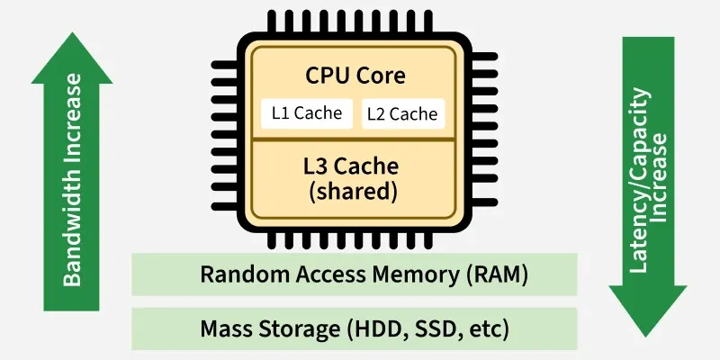
Cache Memory
The cache memory is used to store program data that is currently being executed in the CPU. Whenever the CPU needs to access memory, it first checks the cache memory. If the data is not found in cache memory then the CPU moves onto the main memory.
Registers
These are small, ultra-fast memory locations within the CPU used to hold data that is being processed. Registers are crucial for executing instructions efficiently.

Slide 17
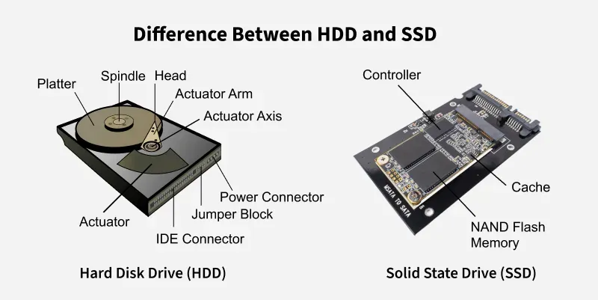
Hard Disk Drive (HDD) vs Solid State Drive (SSD)
Storage devices play a crucial role in determining a computer’s speed, performance, and data access efficiency. Among them, Hard Disk Drives (HDD) and Solid State Drives (SSD) are widely used storage technologies that differ in their working mechanisms.
HDDs using mechanical parts and SSDs relying on flash memory. These differences impact their speed, durability, cost, and overall performance.

Slide 18
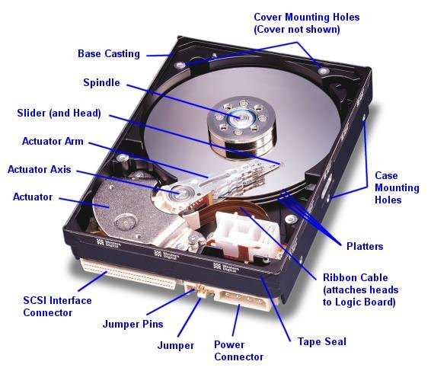

Slide 19
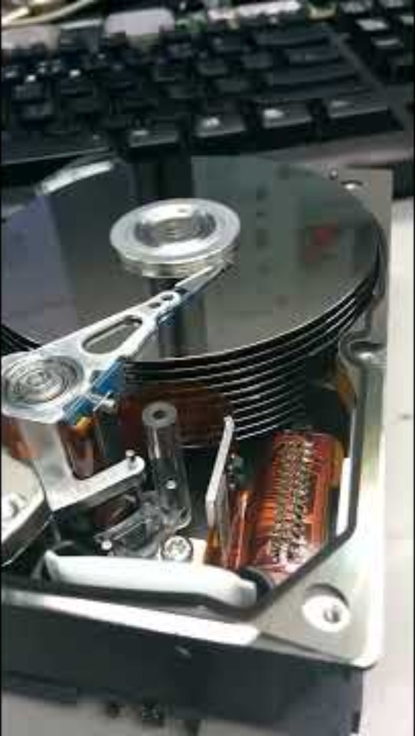
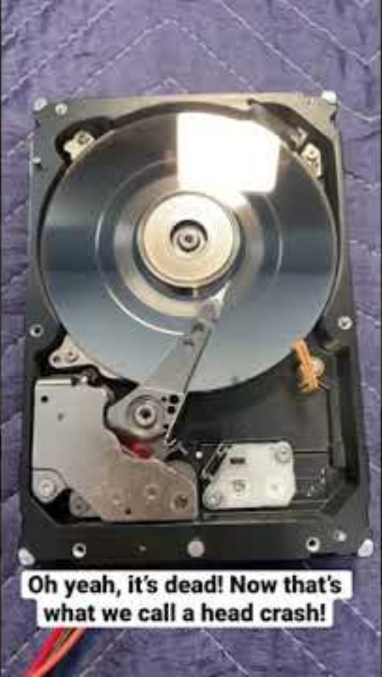

Slide 20
Hard Disk Drive(HDD)
Hard Disk Drive (HDD), which stores data on spinning magnetic platters and uses a read/write head to access information. It is widely used in desktops, laptops, and servers due to its ability to handle large amounts of data efficiently.
Solid State Drive(SSD)
Modern storage devices use electronic memory to deliver faster and more efficient data access. One such technology is the Solid State Drive (SSD), which stores data using flash memory instead of moving parts. This allows quicker read/write operations and improved system performance. SSDs are commonly used in laptops and high-performance systems due to their speed and reliability.

Slide 21
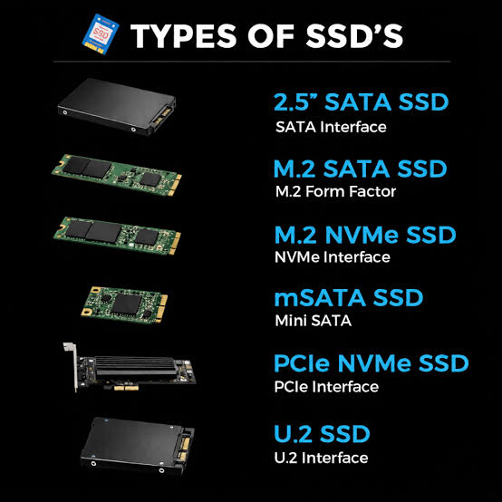
Types of SSD’S

Slide 22
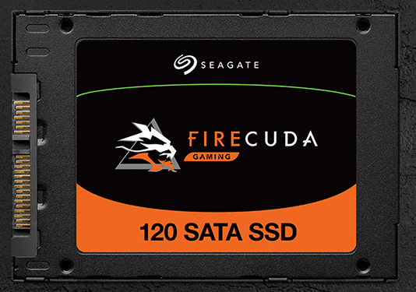
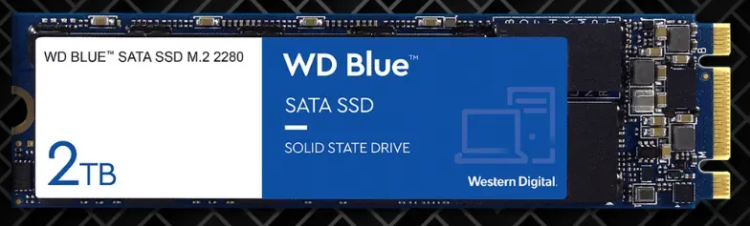
a) SSD SATA 2.5"
The oldest SSD format.
Connected in SATA III (max speed ~550 MB/s).
Compatible with almost all desktop and laptop PCs.
Perfect for a cheap upgrade .
b) SSD M.2 SATA
Use the format M.2 , smaller than the 2.5".
But limited by the SATA interface, so same speeds (≈ 550 MB/s).
Running on laptops and recent motherboards .

Slide 23
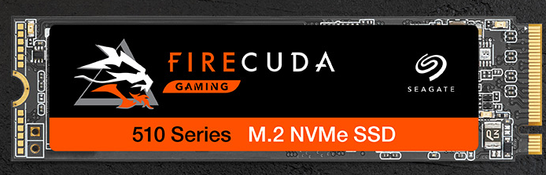
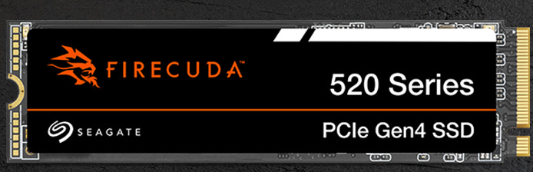
c) SSD M.2 NVMe
The most popular today .
Use the PCIe bus via the M.2 format.
Speeds ranging from 2000 MB/s to over 7000 MB/s depending on the generation (PCIe 3.0, 4.0, 5.0).
Ideal for gamers and content creators.
d) SSD PCIe (Add-in Card)
Presents itself in the form of a PCIe card plugged directly into a PCIe x4 or x16 port.
Mainly used in servers and workstations.
Very high performance, but bulky.

Slide 24
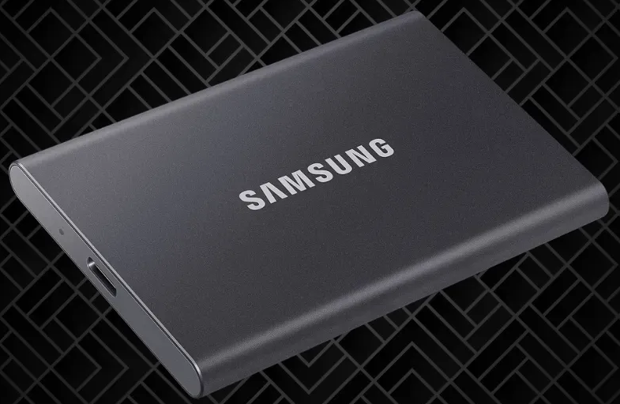
e) External SSD
Connected via USB 3.2, USB 4, or Thunderbolt.
Variable speed depending on the interface.
Convenient for backing up and transporting data.
SSD Speed
A key point that differentiates types of SSDs is their speed.
SATA III → ≈ 500–550 MB/s
NVMe PCIe 3.0 → 2000 to 3500 MB/s
NVMe PCIe 4.0 → 5000 to 7500 MB/s
NVMe PCIe 5.0 → can exceed 10,000 MB/s
SSD size
The SSD size (capacity) is also an important criterion.
250 GB - 500 GB → sufficient for Windows and a few apps.
1 To → the best compromise for OS + software + games.
2 To and more → perfect for big gamers or video creators.

Slide 25
Feature | HDD (Hard Disk Drive) | SSD (Solid State Drive)
Definition | Uses spinning disks and mechanical parts | Uses electronic components (no moving parts)
Storage Technology | Uses spinning magnetic disks for storage. | Uses NAND flash memory with no moving parts.
Speed | Slower boot times and file access. | Much faster boot times and file access.
Durability | Has moving parts, making it prone to damage. | More durable and shock-resistant.
Noise | Produces noise due to spinning disks. | Operates silently.
Power Consumption | Consumes more power. | Uses less power, improving battery life.
Lifespan | Wears out over time due to mechanical movement. | Lasts longer but has limited write cycles.
Data Fragmentation | Performance can suffer from fragmentation | No fragmentation; performance remains consistent

Slide 26
Conclusion of SSD and HDD
SSD is preferred for fast performance because it has no moving parts and provides quick booting, faster application loading, and rapid data access. Therefore, SSDs are commonly used for operating systems, software, gaming, and high-performance applications.
HDD is preferred for economical, high-capacity storage because it offers more storage at a lower cost per GB. Therefore, HDDs are commonly used for backups, CCTV recordings, large media collections, and long-term data storage.
HDD = High Capacity + Low Cost + Mechanical Storage
SSD = High Speed + No Moving Parts + Flash Storage

Slide 27
Flash Media
Flash media is a type of non-volatile storage that stores data electronically and retains it even when the power is switched OFF. It uses NAND flash memory and has no moving mechanical parts.
Common examples of Flash Media:
SD Cards
microSD Cards
USB Flash Drives
Compact Flash Cards
USB Memory Sticks
Flash media is widely used because it is small, portable, lightweight, durable, and provides quick access to data.

Slide 28
How Flash Memory Works
Flash memory stores data in small electronic cells. The data stays saved even when the device is switched OFF.
Simple Process:
Save Data:
Device → Flash Memory → Data is Stored
Read Data:
Flash Memory → Device → Data is Used
Unlike an HDD, flash memory has no spinning disks and no moving parts. This makes flash storage small, fast, quiet, and more resistant to physical shocks

Slide 29
SD Cards
An SD (Secure Digital) card is a small removable flash-storage device commonly used to store and transfer digital data.
Different forms include:
SD Card: Commonly used in cameras and other larger devices.
microSD Card: Smaller version commonly used in smartphones, tablets, drones, and action cameras.

Slide 30
Real-Life Applications of SD Cards
Digital Cameras: SD cards store photographs and high-resolution videos captured by cameras.
Smartphones and Tablets: microSD cards can provide additional storage for photos, videos, music, and documents in devices that support expandable storage.
Drones and Action Cameras: Used to record high-resolution photographs and videos.
Gaming Devices: Used for storing games, downloadable content, screenshots, and other files.
CCTV and Security Cameras: Some cameras use microSD cards for local video recording.
Embedded Devices: Used to store software, configuration files, maps, and other data.

Slide 31
Features of SD Cards
Non-volatile: Data remains after power is removed.
Portable: Very small and easy to carry.
Removable: Can be transferred between compatible devices.
No moving parts: More resistant to physical shock than HDDs.
Different capacities and speeds: Available for different applications.

Slide 32
Secondary memory is of two types:
1. Fixed devices
2. Removable devices
Fixed storage is also known as fixed disk drives or hard drives. Here data is stored in a built-in fixed storage device.
Types of fixed storage:
SSD (solid-state disk)
Hard disk drives (HDD)

Slide 33
Removable devices
Removable storage is also known as external drives.
It is a storage device that can be inserted or removed from the computer according to our requirements. They are portable so that we can easily transfer data from one computer to another. Also, they provide the fast data transfer.
Types of Removable Storage:
Optical discs (like CDs, DVDs, Blu-ray discs)
Memory cards
Floppy disks
Magnetic tapes

Slide 34
USB Flash Drive
A flash drive, also called a USB flash drive or pen drive, is a small portable storage device used to store and transfer digital data.
Storage: Uses flash memory to store files such as documents, photos, videos, and music.
Connection: Usually connects to a computer through a USB port.
Portable: Small, lightweight, and easy to carry.
No moving parts: Unlike traditional hard drives, flash drives have no mechanical moving components.
Data transfer: Can quickly copy or move files between compatible devices.
Capacity: Available in different storage capacities, commonly from a few GB to hundreds of GB or more.

Slide 35
Real-Life Applications of USB Flash Drives
File Transfer: Used to transfer documents, photographs, videos, presentations, and other files between computers.
Data Backup: Important files can be copied to a USB drive as an additional backup.
Operating-System Installation: A bootable USB drive can be used to install or repair an operating system.
Educational Use: Students and teachers can carry assignments, presentations, notes, software, and study materials.
Business Use: Used for transferring reports, presentations, documents, and other work-related files.

Slide 36
Advantages of Flash Media
Non-volatile: Data is retained without power.
Portable: Easy to carry and transfer.
Compact: Requires very little physical space.
Durable: No mechanical moving parts.
Fast: Provides relatively quick data access.
Convenient: Can be easily connected or removed from compatible devices.
Energy efficient: Generally consumes little power during operation.

Slide 37
Disadvantages of Flash Media
Flash memory has a limited number of program/erase cycles.
Performance and durability vary between different types and qualities of flash products.
Small devices such as USB drives and SD cards can be easily lost or damaged.
Data can become inaccessible if the memory controller or flash cells fail.
It should not be considered the only backup of important data.

Slide 38
Comparision Between SD Card and USB Flash Drive
Feature | SD Card | USB Flash Drive
Main purpose | Device storage | File transfer/storage
Common devices | Cameras, phones, drones | Computers, laptops
Size | Very small | Small
Portability | Very high | High
Technology | NAND Flash | NAND Flash
Moving parts | None | None
Data retention | Non-volatile | Non-volatile
Connection | SD/microSD slot | USB port

Slide 39
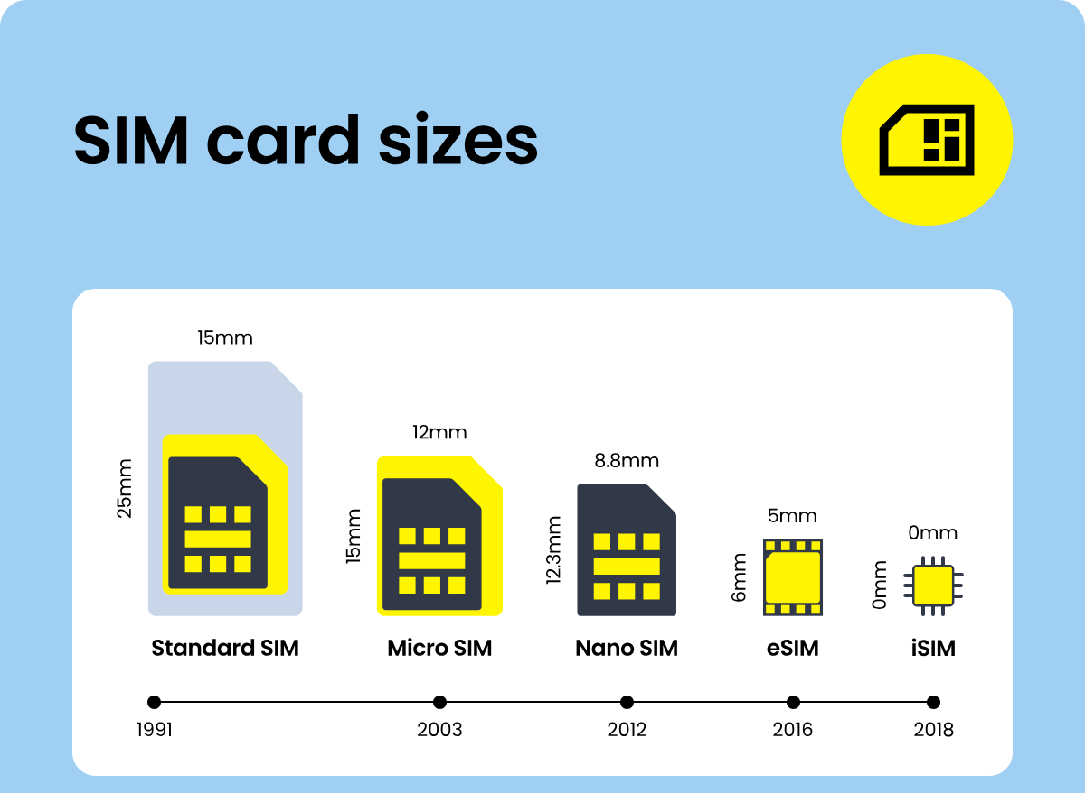

Slide 40
Conclusion of Flash Media (SD Card and USB Drives)
Flash media is an important type of non-volatile storage that provides a simple, portable, and reliable way to store and transfer data. Since it has no moving parts, it is compact, lightweight, fast, and more resistant to physical damage than traditional mechanical storage.
SD cards are mainly used in digital cameras, smartphones, drones, and other portable devices, while USB flash drives are commonly used for file transfer, data storage, backup, and operating-system installation.
In simple words: Flash Media = Portable + Fast + Durable + Non-Volatile Storage.

Slide 41
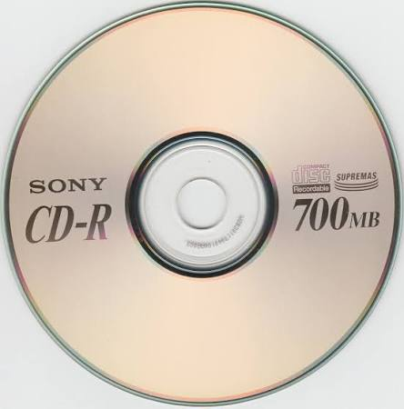
Compact Disc
A Compact Disc (CD) is a commonly used secondary storage device. It contains tracks and sectors on its surface. Its shape is circular and is made up of polycarbonate plastic. The storage capacity of CD is up to 700 MB of data. A CD may also be called a CD-ROM (Compact Disc Read-Only Memory). CD is of two types:
CD-R (compact disc recordable): Once the data has been written onto it cannot be erased, it can only be read.
CD-RW (compact disc rewritable): It is a special type of CD in which data can be erased and rewritten as many times as we want. It is also called an erasable CD.

Slide 42
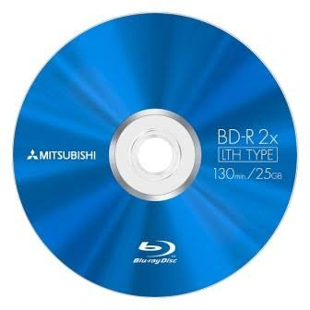
Blu-ray Disc
A Blu-ray disc looks just like a CD or a DVD but it can store data or information up to 25 GB data. If you want to use a Blu-ray disc, you need a Blu-ray reader. The name Blu-ray is derived from the technology that is used to read the disc ‘Blu’ from the blue-violet laser and ‘ray’ from an optical ray.

Slide 43
Section A — 1 Mark Each (Direct Recall)
1. Which RAM type needs to be refreshed thousands of times per second to retain data?
a) SRAM b) DRAM c) PROM d) EEPROM
2. SRAM is generally used for which of the following?
a) Main memory b) CPU cache c) Secondary storage d) Optical discs
3. Which memory type can be programmed only once by the user using a special device?
a) EEPROM b) EPROM c) PROM d) DRAM
4. EPROM data can be erased using:
a) Electric current only b) Ultraviolet light c) Magnetic field d) Software command only
5. Which type of ROM can be erased and reprogrammed electrically, in-circuit, without removing the chip?
a) PROM b) EPROM c) EEPROM d) SRAM

Slide 44
6. Why is SRAM faster than DRAM?
a) It uses capacitors b) It uses flip-flops (transistors) and needs no refreshing c) It has more storage capacity d) It is a type of secondary storage
7. Which of these is volatile memory?
a) ROM b) Flash drive c) RAM d) HDD
8. In an SSD, data is stored using:
a) Magnetic platters b) Flash memory chips c) Optical laser d) Capacitor refresh cycles
9. Which secondary storage device has moving mechanical parts (read/write head and spinning platter)?
a) SSD b) HDD c) USB flash drive d) SD card
10. Which of the following is an example of flash-based secondary storage?
a) HDD b) CD-ROM c) Pen drive (USB flash drive) d) DRAM stick

Slide 45
Section B — 5 Marks Each (Scenario-Based, Middle Level)
11. Rohan's laptop feels slow to start up. His friend suggests replacing the HDD with an SSD. What is the MOST likely reason this will speed up boot time?
a) SSDs have more storage capacity than HDDs
b) SSDs have no moving parts and access data electronically, giving much faster read/write speeds
c) SSDs use DRAM instead of flash memory
d) SSDs are cheaper than HDDs
12. A computer lab technician wants memory that is fast but doesn't need constant refreshing, to use as CPU cache. Which should they choose, and why?
a) DRAM — because it's cheaper per bit
b) SRAM — because it retains data using transistors without needing refresh cycles, making it faster
c) EEPROM — because it's non-volatile
d) HDD — because it has large capacity
13. A company manufactures 10,000 identical calculators, each needing the same fixed firmware that will never change. Which ROM type is most cost-effective for mass production?
a) EEPROM, since it can be reprogrammed
b) EPROM, since UV light can erase it
c) PROM (or mask ROM), since the same fixed data is written permanently at low cost per unit
d) SRAM, since it's fast
14. An engineer needs to update firmware in a device periodically without physically removing the chip or using UV light. Which memory type fits best?
a) PROM b) EPROM c) EEPROM d) DRAM

Slide 46
15. A student stores a project file on a USB pen drive, unplugs it, and later plugs it into another computer — the file is still there. What property of flash memory explains this?
a) It is volatile b) It is non-volatile — it retains data without power c) It needs constant refreshing d) It only works while connected to power
16. A gaming PC builder has a budget for only ONE new drive and wants the best mix of large storage capacity and low cost per GB for storing a large game library. What should they most likely pick?
a) SSD, because it's non-volatile
b) HDD, because it generally offers more storage capacity per rupee spent than SSD
c) SRAM, because it's the fastest memory
d) EEPROM, because it's reprogrammable
17. A digital camera needs a memory type that is compact, has no moving parts (to survive shocks), and retains photos even when the battery is removed. Which technology fits?
a) DRAM b) SRAM c) Flash memory (e.g., SD card) d) HDD

Slide 47
18. While assembling a PC, a technician mistakenly swaps RAM modules with a smaller EEPROM chip meant for BIOS storage. What problem will likely occur?
a) None — both are volatile memory, so they're interchangeable
b) The system will fail to run properly, since EEPROM is much slower and far smaller in capacity than RAM used for main memory
c) EEPROM is faster than RAM, so performance will improve
d) EEPROM will refresh itself like DRAM
19. A hospital's server needs storage that is very reliable, fast, and resistant to physical shock (important in a moving equipment cart). Between HDD and SSD, which is more suitable, and why?
a) HDD, because it's cheaper
b) SSD, because it has no moving parts, making it more shock-resistant and reliable in motion
c) HDD, because it has larger capacity
d) Either works equally well for shock resistance
20. A teacher explains that BIOS settings changed by a user (like boot order) are saved even after the computer is switched off and unplugged for days. Which memory type stores these settings?
a) DRAM, because it's fast
b) SRAM, because it's used as cache
c) A small EEPROM/CMOS memory chip, because it is non-volatile and can be rewritten
d) Volatile RAM, because settings need to reload each time

Slide 48
Answer Key
1-b, 2-b, 3-c, 4-b, 5-c, 6-b, 7-c, 8-b, 9-b, 10-c, 11-b, 12-b, 13-c, 14-c, 15-b, 16-b, 17-c, 18-b, 19-b, 20-c

Slide 49
What is the main difference between HDD and SSD?
A HDD uses flash memory, SSD uses magnetic disks
B HDD uses mechanical parts, SSD uses electronic memory
C Both use mechanical parts
D Both use magnetic storage
Which storage device provides faster data access and boot time?
A HDD
B SSD
C CD-ROM
D Floppy Disk

Slide 50
Why is SSD considered more durable than HDD?
A It uses magnetic disks
B It has larger storage
C It has no moving parts
D It is cheaper
Which device is more cost-effective for large data storage?
A SSD
B HDD
C Both are equal
D Optical Disk
What is a disadvantage of HDD compared to SSD?
A Higher power consumption
B Silent operation
C Faster performance
D No fragmentation

Slide 51
Thank You

